Slide 1
Origin of the wood used by forest industry in 2024
Total 62.7 mill. m³ (2% more than in 2023)
SOURCE: Luke

Slide 2
The wood consumption was 62,6 mill. m³ in 2024
In addition to the roundwood the industry used 8,7 mill. m³ sawmill chips
SOURCE: Luke

Slide 3
Use of domestic wood
SOURCE: Luke

Slide 4



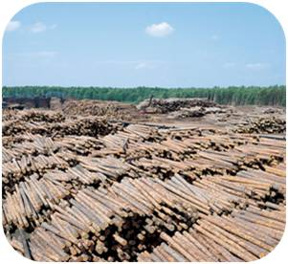
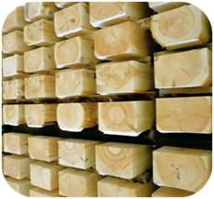

Wood flow from forest to mill in Finland 2024 (mill. M³)
Imported raw wood
4
Annual increment 15 mill. m³
4
Annual growth
103
Total drain
90
Total removals
74
Commercial roundwood (*)
62
Industrial roundwood (*)
63
Pulp and paper industry
31 + 7,9
31
55
7,9
90
Chips
8,7
2,0
15
28
Firewood 7
Chips 8
Roundwood exports
2,0
Wood products industry
28 + 0,8
Logging residues,
Natural drain
16
(*) Removals and use data may
differ due to stocks
SOURCE: Luke

Slide 5
Imports and exports of wood raw material
SOURCE: Tulli, Luke

Slide 6
Imports of wood raw material in 2024 was 5,6 mill. m³
(with bark)
By countries
By products
SOURCE: Tulli, Luke

