Slide 1



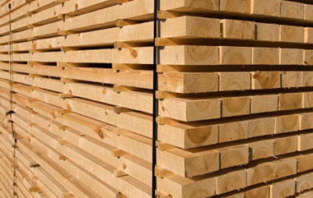

Production and export of the forest industry
¹ part of production is estimated
² export of sawn and planed goods
Source: FFIF and Finnish Customs

Slide 2
Export volume of the forest industry
*Sawn wood also includes planed wood
Source: Finnish Customs

Slide 3
Export value of the forest industry
*Sawn wood also includes planed wood
Source: Finnish Customs

