Slide 1



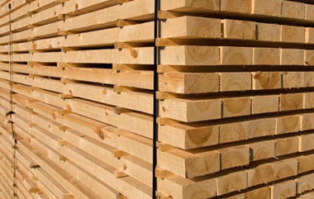

Production and Exports of the Forest Industry
*The production volume is partly estimated.
Sawn wood exports also include planed timber exports.
Source: FFIF and Finnish Customs

Slide 2
Export Volumes of the Forest Industry
*Sawn wood exports also include planed timber exports.
Source: Finnish Customs

Slide 3
Export Values of the Forest Industry
*Sawn wood exports also include planed timber exports.
Source: Finnish Customs

