Slide 1
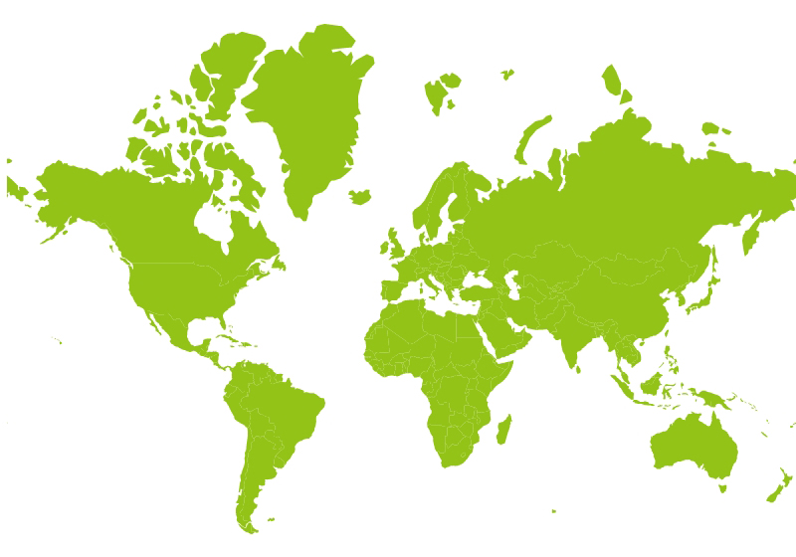
Export Markets for Finnish Forest Industry 2025
9%
59%
22%
6%
Finnish forest industry export including Furniture industry.
1%
3%
Source: Finnish Customs

