Slide 1

Finnish Forest Industry Export Markets

Slide 2
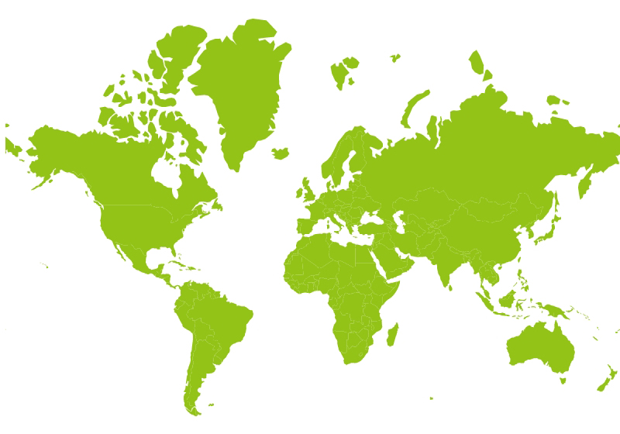
Export Markets for Finnish Forest Industry
10 %
59 %
21 %
6 %
Finnish forest industry export including Furniture industry
1 %
3 %
Source: Finnish Customs

