Slide 1
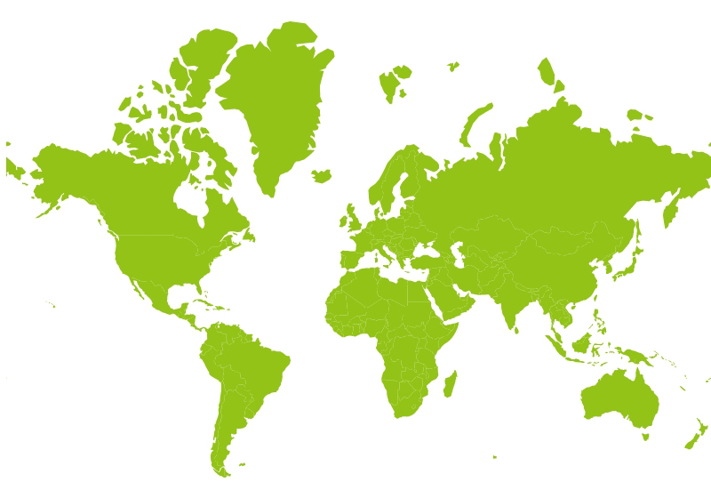
Distribution of export market for Finnish forest industry products in 2024
0,1 %
59 %
10 %
21 %
6 %
Finnish forest industry export including Furniture industry
1 %
3 %

