Slide 1
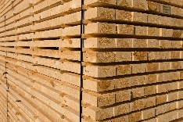
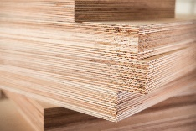
Production and export of the forest industry
¹ estimate
² export of sawn and planed goods
SOURCE: FFIF and Finnish Customs

Slide 2
Export of the forest industry
Sawn wood: export of sawn and planed goods
SOURCE: Finnish Customs

Slide 3
Export of the forest industry
Sawn wood: export of sawn and planed goods
SOURCE: Finnish Customs

